Slide 1
Monthly Merit Process Update Meeting
Sri Kamarthi
Associate Director
July 2021

Slide 2
Agenda
System Member Statistics
Merit Dashboard
Completing Merit Configuration Worksheet and Merit SOR Forms
Merit Statements
Merit Partner Responsibilities
Merit on Workday help site

Slide 3
System Member Statistics
8 System Members have submitted the Merit Configuration Worksheet
5 – Centralized option
2 – Distributed with Delegations
1 – Manager
Merit Entry Options
5 – PBA first then Workday
3 – Workday first and then PBA
Merit Pools
5 – Not using pools in Workday
3 – Using pools in Workday

Slide 4
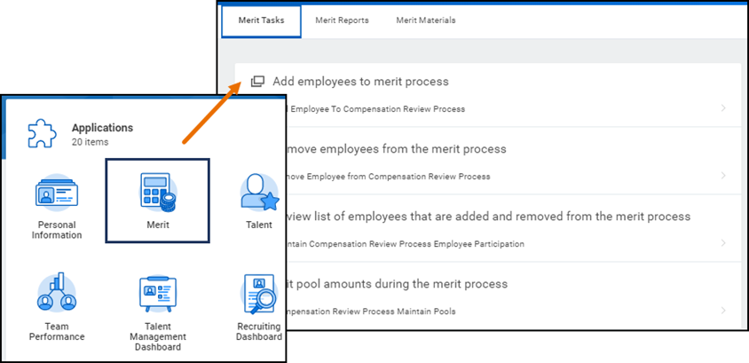
Merit Dashboard
Merit Partners will have access to a Merit Dashboard as a one-stop-shop for
Merit related tasks
Merit Reports
Links to training materials

Slide 5
Merit configuration Worksheet
Each system member selects the timeframe merit process is open
New section added to indicate what type of Merit Statement would be used

Slide 6
Merit SOR Form
Merit Configuration Worksheet and Merit SOR form are available on Workday help site
Merit SOR Form is not needed if you already have Merit Partner access from last year
You can verify your access by looking at the Merit Dashboard on Workday homepage
Merit Point of Contact collects all the SOR forms and sends them along with Merit Configuration Worksheet

Slide 7
Customized merit statement
Merit Statement generated from Workday has been customized to include monthly rate for salaried employees and hourly rate for biweekly paid employees
Reduces the manual effort of preparing merit statement for each employee
Merit Statement generated from Workday can only be used if the merit process is launched and completed in Workday
Members can choose to finalize Merit in Sandbox first and release the merit statements to decide if they want to use them

Slide 8
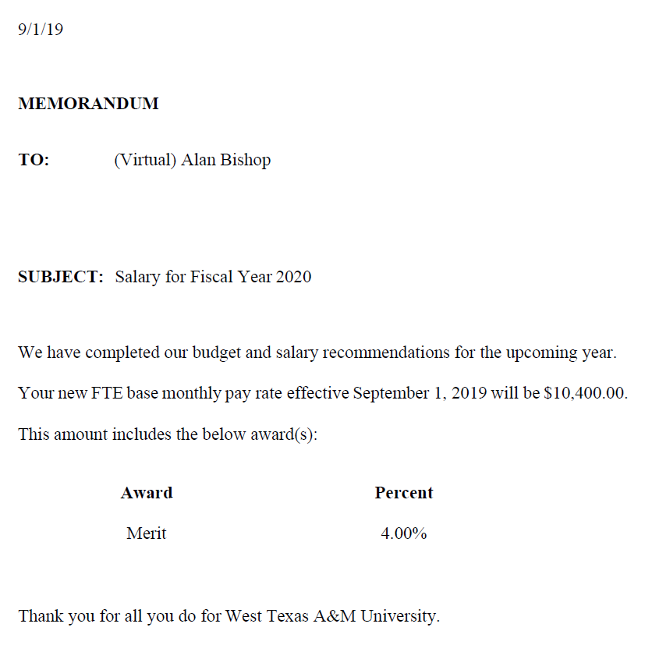
Customized merit statement - preview
New final monthly or hourly rate will be displayed based on the pay rate type of the Employee
All three award types are displayed in a table in the order of Merit, Additional Adjustment and Promotion
Notes:
Memo should say “Thank you for all you do for The Texas A&M University System”

Slide 9
Merit partner Responsibilities
Merit Partners are the primary person responsible for the Merit process. They are the primary contact for communication between the system member and Workday Services. Some members may have more than one Merit Partner. In this case the system member will need to designate one primary point of contact
Merit Partner responsibilities include:
Confirm Sandbox testing dates and schedules
Coordinate internal testing in Sandbox
Coordinate internal training for Merit Partners and Managers (if applicable)
Participate in Monthly Merit Process Update meetings
Frequently run reports and verify information
Give final go-ahead for Merit Finalization and Releasing Merit Statements

Slide 10
Verify Merit Plan Assignments
Use the Annual Merit Process Eligibility report to:
Audit Merit Plan assignments as per system member requirements
Prompts to be used
Effective Date: Defaults to today’s date
TAMUS System Member Part: Provides results for all employees within the system member selected

Slide 11
Report Sample
Available columns for filtering data include:
Employee Type
Job Profile
Primary Position (Yes/No)

Slide 12
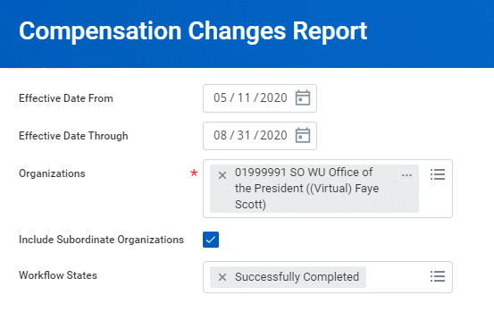
Monitor Compensation Changes
Use the Compensation Changes report to
Audit and identify Compensation Changes after the Position Budgeting Application snapshot of Workday
Audit in progress changes after Merit is initiated
When the in progress change gets approved, then the merit that was entered on the grid would be cleared and need to be entered again
Audit in progress changes before Merit is finalized
If any employee has in progress compensation change when the merit is finalized, merit award would be on hold
Merit Partners can use Compensation Review Awards On Hold Audit report to view the list of employees who have their merit process award on hold
Note: Use 9/1 for From and Through dates to see Merit Awards. Employees with multiple awards will be identified in multiple rows, one per award

Slide 13
Upcoming Merit Events and Trainings
Date | Event
07/07/2021 | Merit Planner/Manager Training (Repeat)
07/31/2021 | Due Date to submit EIB Request for One time Merit
08/10/2021 | Monthly Merit Process Update meetings
Notes:
Should any of these dates be moved up to align with Launching of Merit?

Slide 14
One Time Merit Lump Sum EIB
Merit Configuration Worksheet still needs to be completed
EIB request is due by 7/31/2021 for One Time Merit Lump Sum payments effective 9/1/2021
Payments
Biweekly employees are paid: September 10, 2021
Monthly employees are paid: October 1, 2021
Payments can be validated in Workday using the One-Time Payments report

Slide 15
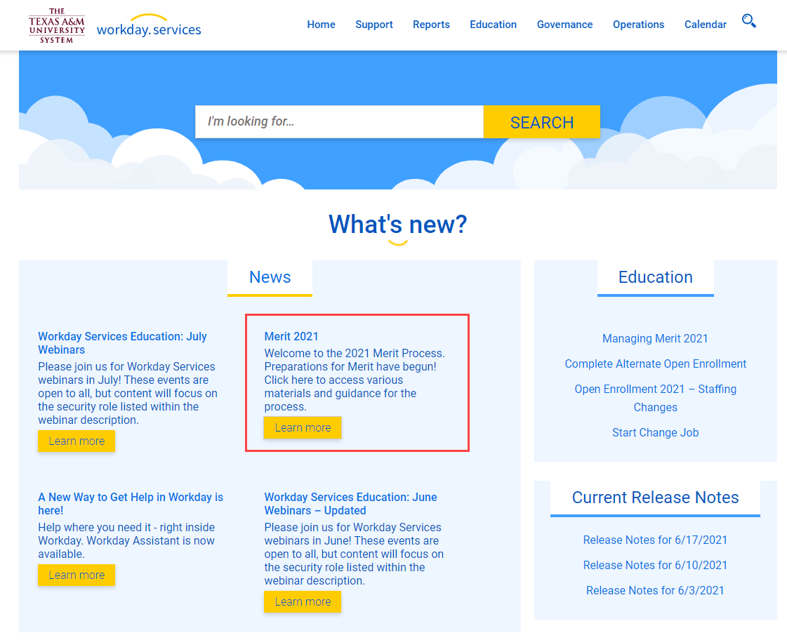
Merit on Workday help site
All merit related job aids, reference guides, webinar recordings and presentations are available on Workday help site

Slide 16
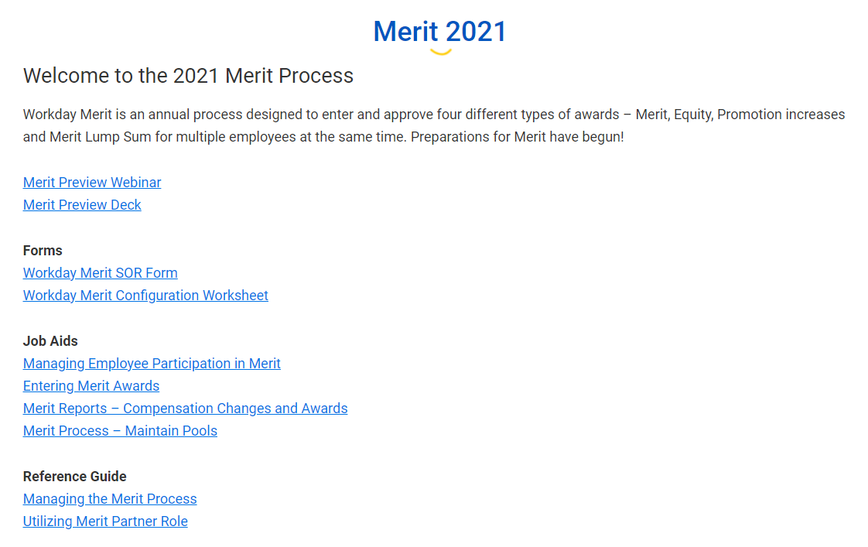
Merit on Workday help site
All merit related job aids, reference guides, webinar recordings and presentations are available on Workday help site

Slide 17
Key takeaways
Merit Partners will have access to a Merit Dashboard on Workday home page as a one-stop-shop for Merit related tasks, reports and training materials
Merit Partner role can be assigned at a different levels to reduce work load and improve direct support during the merit process
Customized Merit Statement can only be used if the Merit process is launched and completed within Workday
Completed Merit Configuration Worksheet must be submitted at least three weeks prior to launch in production

