Slide 1
Merit 2021 Preview
Sri Kamarthi
Associate Director
April 2021

Slide 2
Agenda
Overview of Workday Merit
What’s Remaining the Same?
Merit Process Improvements
Merit Process Options and Timeline
Summary and Next Steps
Q & A

Slide 3
Today’s Goals
Understand and get familiar with Merit Process
Know about the merit process improvements
Know the importance of Merit Partner role
Know about the available merit options and timelines

Slide 4
Overview of workday merit

Slide 5
Workday Merit is…
The Workday Merit business process can be described as:
Comprehensive – You can approve four different types of compensation changes effective on the same day (e.g. 9/1/2021)
Merit Award Increase
Additional Increase
Promotion/Reclassification Increase
One-time Merit Lump-sum
Flexible – You can enter awards for multiple employees using one grid
Transparent – Ratings from Performance Reviews feed into the grid and can guide the merit entry process

Slide 6
What’s remaining the same?

Slide 7
Consistent Features from Last Year
Merit Partner will complete the Merit Process Worksheet to communicate a plan for how the process should be carried out
Separate merit plans will be used for Staff and Faculty
A standard merit plan naming convention will be used
“XX SYS_NAME Merit Plan –Worker_Type” (e.g. 02 TAMU Merit Plan – Staff)
Merit Target % will be hidden from the Employee
A standard merit grid will be used across all system members
Options exist for Merit, Additional Adjustment (Equity), Lump Sum and Promotion
Overall Rating from annual performance reviews feeds into the merit grid
Any Employee who receives an overall rating of Does Not Meet Expectations will not be eligible for merit
The Overall Rating can be changed directly within the grid
Rating does not tie back to Performance Review
Notes:
How do you locate the Merit Process Worksheet?

Slide 8
Merit Process Worksheet
Each system member selects the timeframe merit process is open
Each system member chooses to include / exclude Additional Jobs and/or Adjuncts in the process

Slide 9
Merit Entry Options
Options for system members to move merit awards from Workday to PBA (Position Budgeting Application) and vice versa
Reduces the manual work in entering awards multiple times
Utilizes existing reports for auditing data

Slide 10
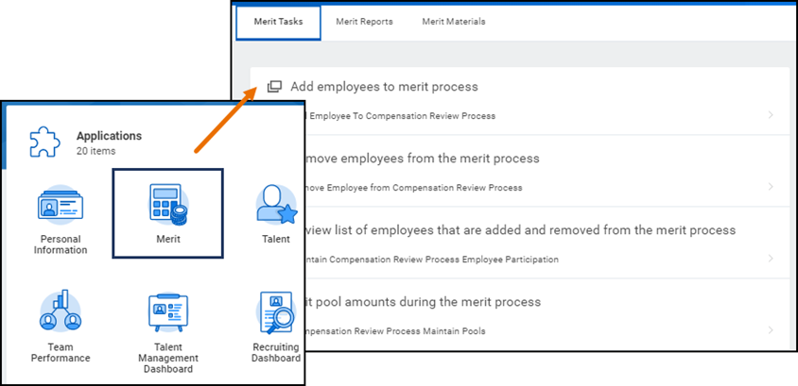
Merit Dashboard
Merit Partners will have access to a Merit Dashboard as a one-stop-shop for
Merit related tasks
Merit Reports
Links to training materials

Slide 11
Merit Process Improvements

Slide 12
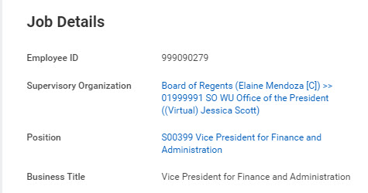
EIB upload to workday
EIB files for members who will be moving awards from Position Budgeting Application(PBA) to Workday will be created using ADLOC instead of Position ID Workstation
Helps to segregate Employees to match Merit Plan in Workday and makes sure that they are in the correct EIB file
Reduces errors and missing award amounts during EIB load

Slide 13
Customized merit statement
Merit Statement generated from Workday can now be customized to include monthly rate for salaried employees and hourly rate for biweekly paid employees
Personalized text can be added based on the award types received by the employee
Reduces the manual effort of preparing merit statement for each employee
IMPORTANT: Customized Merit Statement will be same for all system members. Personalized text and format will be finalized after discussions with the Merit Working Group members
Merit Statement generated from Workday can only be used if the merit process is launched and completed in Workday

Slide 14
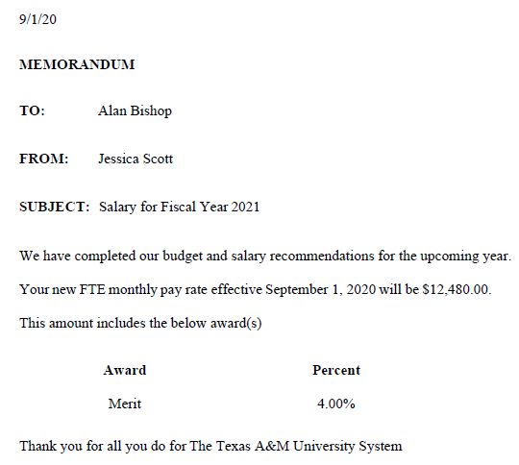
Customized merit statement - preview
New final monthly or hourly rate will be displayed based on the pay rate type of the Employee
All three award types are displayed in a table in the order of Merit, Additional Adjustment and Promotion
If the Employee receives a one-time lump sum payment, that award can also be displayed
Notes:
Memo should say “Thank you for all you do for The Texas A&M University System”

Slide 15
Merit partner role
Merit Partner role has now been improved by restricting access only to the assigned supervisory organizations
The Merit Partner role can be assigned at a different levels (Vice President, college, department etc.) depending on the needs of your member
Assigning this role at a lower college level reduces work load and improves direct support during the merit process by improving
Results response time
Security and confidentiality of data
President’s Office
Merit Partner: Jessika
College of Architecture
Merit Partner: Jane
College of Liberal Arts
Merit Partner: Andy
College of Sciences
Merit Partner: Eric

Slide 16
Merit Partners

Slide 17
Responsibilities
Merit Partners are the primary person responsible for the Merit process. They are the primary contact for communication between the system member and Workday Services. Some members may have more than one Merit Partner. In this case the system member will need to designate one primary point of contact
Merit Partner responsibilities include:
Confirm Sandbox testing dates and schedules
Coordinate internal testing in Sandbox
Coordinate internal training for Merit Partners and Managers (if applicable)
Participate in Monthly Merit Process Update meetings
Frequently run reports and verify information
Give final go-ahead for Merit Finalization and Releasing Merit Statements

Slide 18
role assignment
Merit Partner primary point of contact for each system member submits list of Merit Partners for each supervisory organization in the Merit Configuration Worksheet
New Employees who need Merit Partner security roles should complete the SOR form and send it to their respective Merit Partner primary point of contact
Merit Partner primary point of contact collects all the SORs and sends them along with the Merit Configuration Worksheet
Note: Merit Configuration Worksheet and Merit SOR form are available in Merit section of Workday help site

Slide 19
Merit Process Options and Timeline

Slide 20
Options for Merit Entry
There are two options you can use to complete the merit process
Option 1: Enter merit awards in Workday first, then upload to PBA
Option 2: Enter merit awards in PBA first, then upload via EIB to Workday

Slide 21
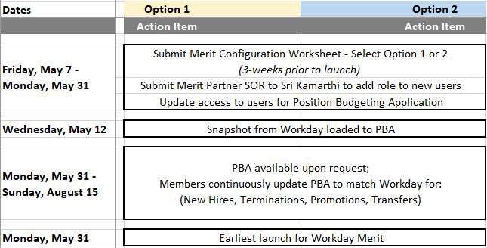
Launching Merit
Run the Compensation Changes report to identify changes between May 12 and September 1
Run the HCM - Actions Needed in PBA report to identify changes effective between the current date and 8/31
Be Aware: Worksheet and SORs are due three weeks prior Merit Launch

Slide 22
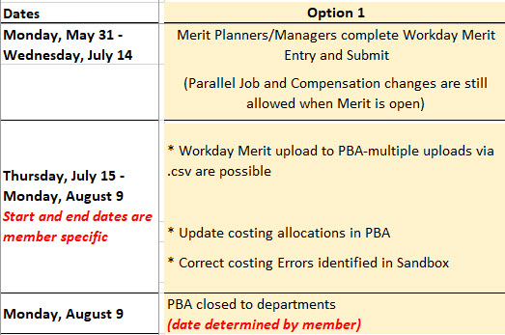
Option 1 – Workday First
Workday is open early to allow time for managers of all levels to enter awards
Run the EDW00217 - HCM Workday Merit Entry for Upload to PBA report can be used to load Workday Merit to PBA
Note: Parallel Jobs and Compensation Changes are allowed while the merit process is open

Slide 23
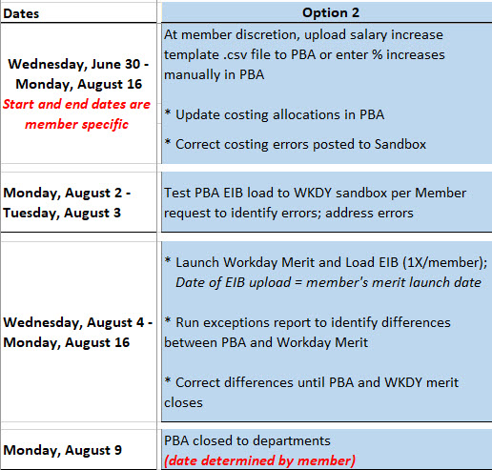
Option 2 – PBA First
PBA will create the EIB file to be loaded to Workday
EIB file will be loaded to Workday Sandbox to identify and correct any errors
Workday Services will launch merit and upload the EIB one-time in production

Slide 24
Upcoming Merit Events and Trainings
The current plan for merit meetings, due dates and trainings is below
Date | Event
06/02/2021 | Merit Planner/Manager Training
06/22/2021 | Monthly Merit Process Update meetings
07/07/2021 | Merit Planner/Manager Training (Repeat)
07/27/2021 | Monthly Merit Process Update meetings
07/31/2021 | Due Date to submit EIB Request for One time Merit
08/10/2021 | Monthly Merit Process Update meetings
Notes:
Should any of these dates be moved up to align with Launching of Merit?

Slide 25
Key takeaways
Merit Partners will have access to a Merit Dashboard on Workday home page as a one-stop-shop for Merit related tasks, reports and training materials
Merit Partner role can be assigned at a different levels to reduce work load and improve direct support during the merit process
Customized Merit Statement can only be used if the Merit process is launched and completed within Workday
Completed Merit Configuration Worksheet must be submitted at least three weeks prior to launch in production

Slide 26
WRAP UP
What’s Next?
Chelsey Michalsky
Learning Resources Manager

Slide 27
Access to Merit Materials

