Slide 1
Financial Systems Modernization
Executive Sponsor Briefing December 14, 2020
Mark Schulz
Deputy CIO

Slide 2
Agenda
Phase II – FAMIS Replatforming Project Status Update
Asysco Update
Additional Statement of Work
Reporting Enhancements Project Update
Questions and Discussion

Slide 3
Phase II – FAMIS Replatforming Project Status Update

Slide 4
Asysco Status Update

Slide 5
Current Status – Factory Exit
Completed
Data Conversion
Execution of all eight test bundles, both online and batch
Conversion of JCL scripts, including utility analysis
Smoke testing of Shadow Solution (test bundles 9 – 12 executed)
Documenting solution for hand-over to TAMUS in early January
No online or batch processes have identified data quality related issues
Connectivity issues to historical data have been problematic, now splitting data into small ‘chunks’

Slide 6
Current Status – Factory Exit continued
Multiple code deliveries received and converted
Differences identified in test results
Differences in batch output are still being reviewed by TAMUS and Asysco / Anubex
Remediated code delivered on December 11 currently being passed through conversion tools
Too early for results
Work on WYLBUR modernization has started

Slide 7
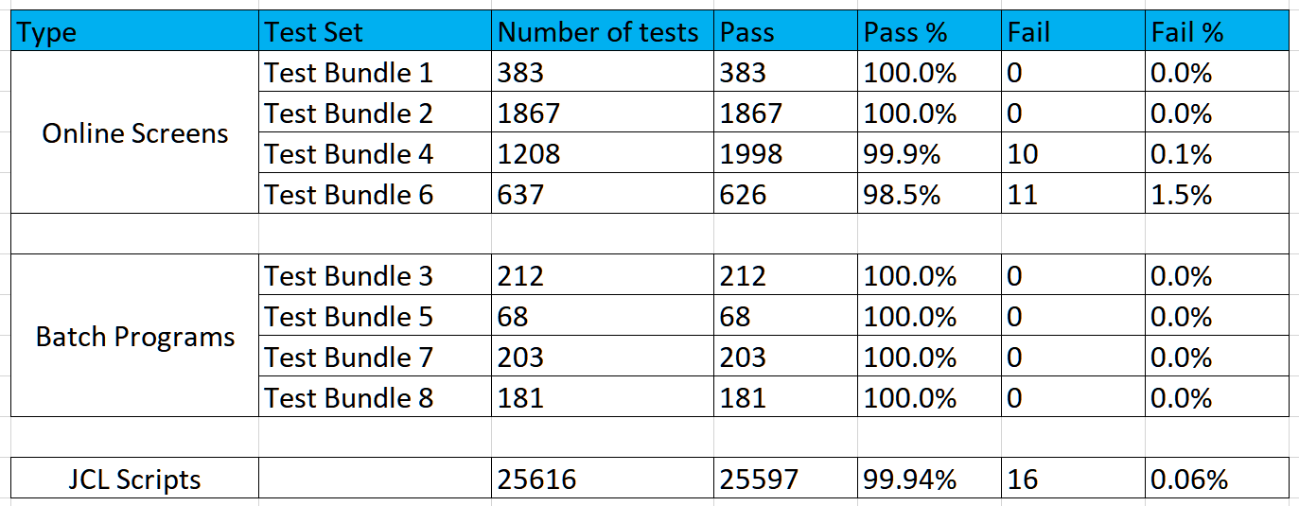
Test Status

Slide 8
Summary
Test Strategy, Planning and Execution focused on next major phase, System Integration Testing
Still some code remediation remains
Changes to be delivered in early January
Despite the ongoing remote work, collaboration across teams remains very positive and productive
Factory Exit close to completion
Known and agreed exceptions will be carried into SIT, including the remaining code remediation

Slide 9
Additional Statement of Work
Additional Anubex and Asysco resources to address the WYLBUR problem
Has become apparent that a “like for like” approach to our operations scripts (JCL) is not feasible
Additional resources will
Replatform and rebuild the operational scripts
Reduce the size and complexity of the operational scripts
Work to automate daily operator choices and steps
Document operator decisions and practices and find ways to automate
Ready the scripts for conversion into Windows PowerShell

Slide 10
Reporting Enhancements Project Update

Slide 11
Decision on Next Steps
Annual Financial Report
Proceed with RFP to procure software
Currently in Procurement for review and posting
Data Catalog / Data Governance
Final product selection in process
Will begin with key FAMIS and Workday elements
BusinessObjects license and upgrade
Strengthen current reporting platform
License additional CPU power
Notes:
We knew that when we modernized our financial system we would need to modernize the reporting that is offered by the A&M System Office of Information Technology; show image of Finance Modernization timeline from October 2019

Slide 12
Questions and Discussion

