Slide 1
Financial Systems Modernization
Executive Sponsor Briefing
September 28, 2020
Mark Schulz
Deputy CIO

Slide 2
Agenda
Phase II – FAMIS Replatforming Project status update
Workstream highlights
Testing update
Upcoming milestones
Phase III update
AFR discovery
Asysco update
Reporting Enhancements Project update
Prism update
People Analytics update
Reporting assessment summary
Questions and roundtable discussion

Slide 3
Phase II – FAMIS Replatforming Project Status Update

Slide 4
Phase II Timeline
February 2020 | Kick-off
June 2020 | All FAMIS code converted to new programming language
October 2020 | Final data conversion model tested and complete
December 2020 | All factory testing complete
June 2021 | System integration testing finishes
December 2021 | User Acceptance testing finishes
February 2022 | Replatformed FAMIS available for use

Slide 5
Workstream Highlights
BMC Control-M installation and implementation in progress
Installation complete on Development and in process on Production
Plan for changeover to full usage set
Installed and available for system integration testing in January
Database design and data conversion
Second version of database is complete and in use
Additional program changes identified
Canopy framework nearing completion
Technical smoke testing complete and Shadow replacement delivered
Initial business process testing has been recorded

Slide 6
Workstream Highlights continued
Managed File Transfer RFP
GoAnywhere from HelpSystems selected
Proof of Concept preparations complete
Implementing TeamDynamix to improve customer service delivery
Office of IT service management tool to track
Requests for new items
Reports of something not working
Pattern of failures
New project requests
On-going projects

Slide 7
Testing Workstream
First phase - Factory Certification – a “smoke” test - Complete
Second phase - Factory Exit
On track for December 2020 completion
Verify mainframe conversion is successful
Eight test recording bundles with over 200 test cases of increasing complexity
Test execution happening with weekly improvements from root cause analysis
Smoke testing for critical integrations like Canopy, Control-M and SQL gateway
Third phase - System Integration Testing
Planned to begin January 2021 and complete June 2021
Will include testing of each type of integration to ensure communication between systems
Will cross-reference and verify identified key business processes

Slide 8
Upcoming Milestones – Factory Exit
Completion of Canopy development and incorporation with smoke testing
Laserfiche and printing integration
Scheduling (Control-M) testing and integration
Automation of data conversion (text files)
Maestro integration technology
New Authentication (sign on) method
Okta project has started with a 12 week timeframe

Slide 9
Phase III Update

Slide 10
AFR Discovery
Procurement discussions started this fall
Vendor demonstrations to be held in spring 2021
Accenture observations
Complex Coordination
Significant Manual Analysis
Limited Automation Capabilities
Unrealized Strategic Potential

Slide 11
Asysco Update

Slide 12
Factory Exit Status Update
Since meeting in August there has been significant progress across numerous workstreams
Eight test bundles received to date
Combination of Online Screens and Batch Processes
Delivery of Data Model 2.0 and acceptance documentation is on schedule
Development work on Entire System Server (ESS) and Shadow Server is complete
Testing continues and will be delivered in October

Slide 13
Testing Status
Online Screens | Number of Tests | Pass | Pass % | Fail | Fail %
Test Bundle 1 | 383 | 381 | 99.90% | 2 | 0.10%
Test Bundle 2 | 1936 | 1651 | 85% | 285 | 15%
Test Bundle 4 | 1208 | 802 | 66% | 406 | 34%
Batch Processes | Number of Tests | Pass | Pass % | Fail | Fail %
Test Bundle 3 | 212 | 138 | 65% | 74 | 35%
Test Bundle 5 | 68 | 60 | 88.20% | 8 | 11.80%
Only Test Bundle 1 has been analyzed and updated for acceptable differences

Slide 14
Summary
Code remediation from TAMUS has been exceptional
Test strategy, planning and execution focused on the next major phase - System Integration Testing
Control-M is a concern at this time; no other major issues or concerns
Progress in Factory Exit continues to be strong with productive collaboration across teams
Project continues to track well

Slide 15
Reporting Enhancements Project

Slide 16
Workday Reporting Implementations
Prism
People Analytics
Project finished on time and under budget
Pre-Payroll Dashboard is live
Event Analysis Dashboard is live
Successfully completed four training webinars
First phase of the project is finished
Waiting to deploy until Workday releases additional features, currently in expanded pilot
Continued collaboration efforts with Workday
Workday Product asked to be in our pilot group
TAMUS influencing People Analytics development

Slide 17
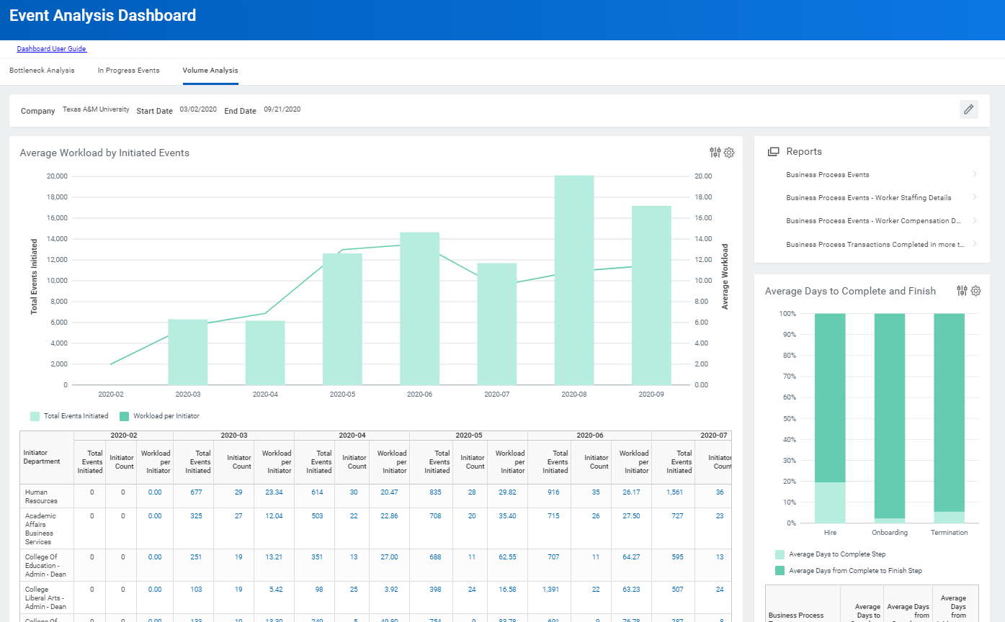
Event Analysis Dashboard
Monitor process volume by Worker
Review overall completion times
Analyze where processes slow down or get reworked

Slide 18
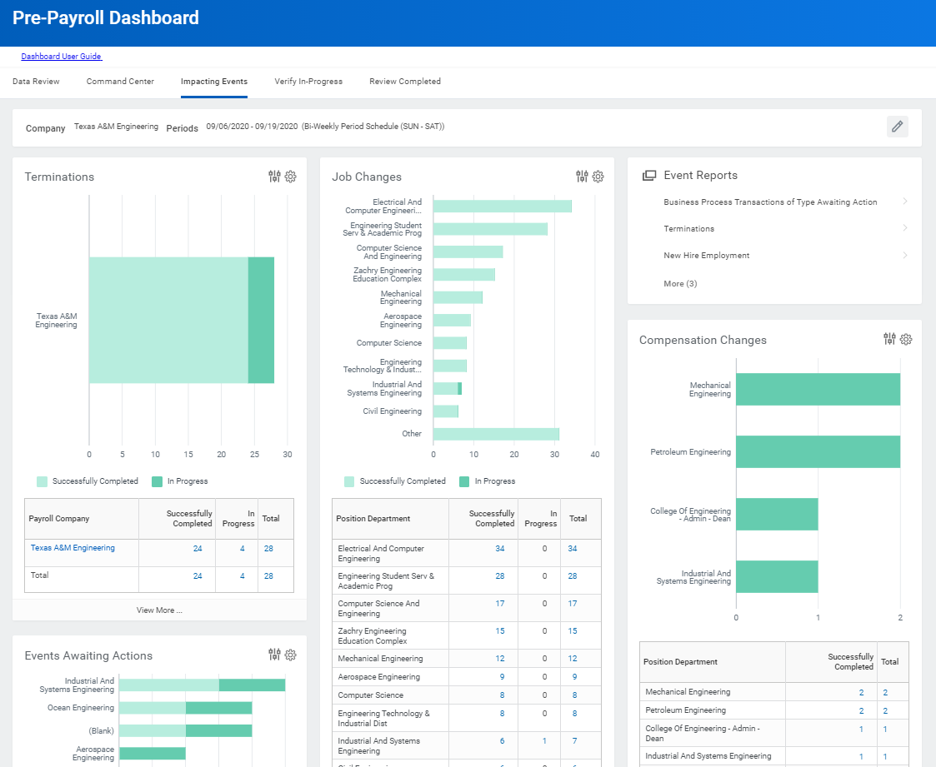
Pre-Payroll Dashboard
We stopped several overpayments by using the Terminations worklet. This directly saves us money since the employee doesn’t always return overpayments.
-Engineering Payroll

Slide 19
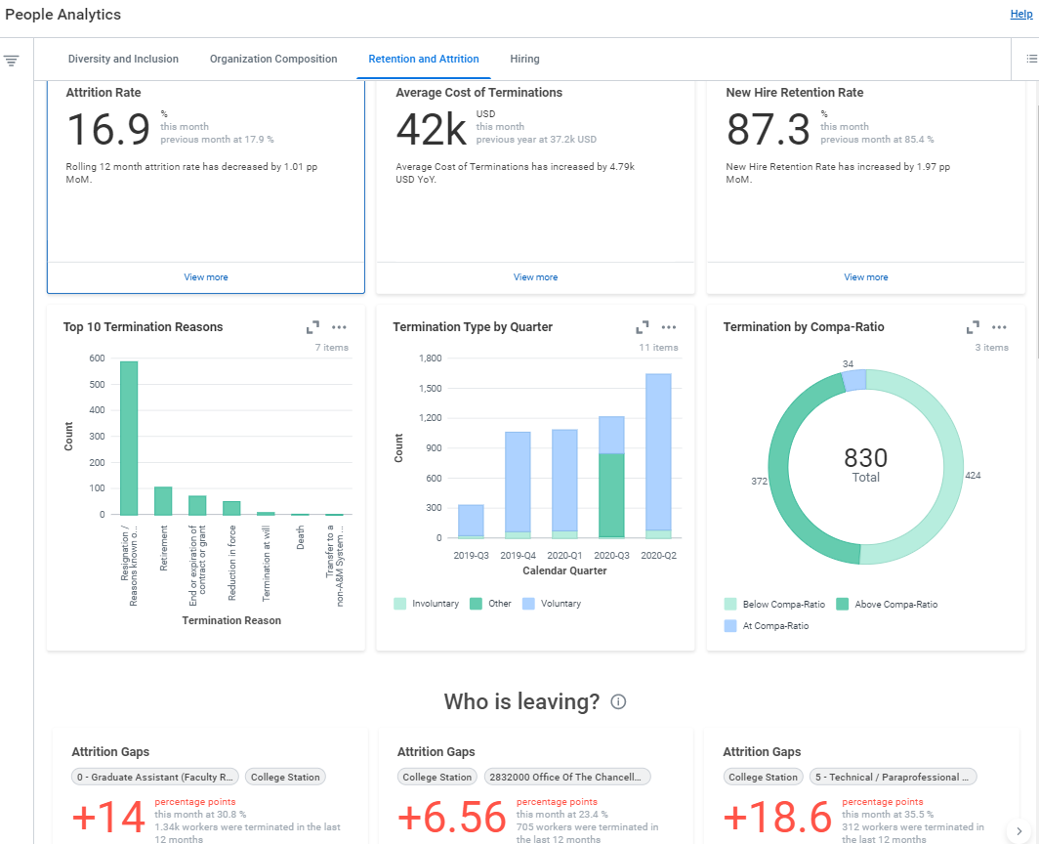
People Analytics
“The goal is to turn data into information, information into insight and insight into a strategic action plan”
- Dr. Giles, Texas A&M Commerce

Slide 20
Accenture Reporting Assessment Update

Slide 21
Reporting Assessment Summary
We asked Accenture to conduct a comprehensive review of enterprise reporting
Analyze the current state - assess capacity, maturity, capability
Recommendations for future state - technologically and organizationally
What needs to change to meet near and future needs?
The analysis was segmented into 10 areas

Slide 22
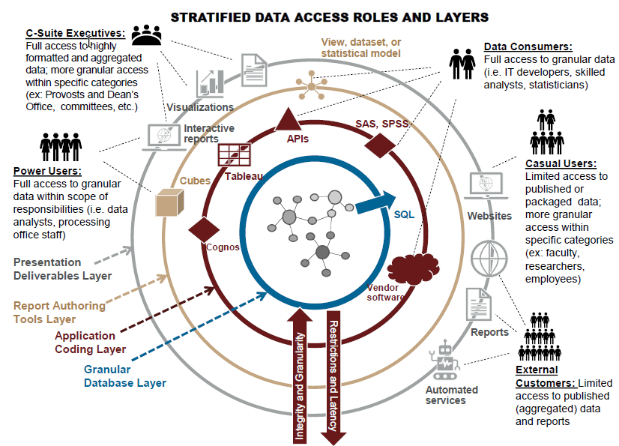
Stakeholder Meetings
24 stakeholder meetings held
10 OIT staff members
40+ stakeholders
Research Administrators
Department Administrators
Budget and Finance Administrators
CFOs
CIOs
Comptrollers
HROs
Dean of Faculty
Academic Analysts

Slide 23
Technical Analysis
Evaluation of the current reporting technology configuration (BusinessObjects)
Assessment of the approach to building the entire reporting environment
Consideration and discussion of alternate approaches and technologies

Slide 24
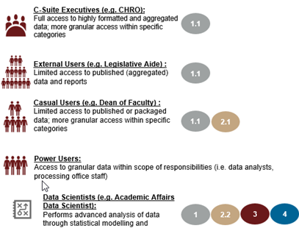
Functional Analysis
How are needs of different data consumer types being met?
What are the short and long term opportunities?
What is working well?
What are the gaps?

Slide 25
Early Takeaways
More data and report curation is needed
Many need more prepared reports
Some need more access to raw data
Data definitions and data governance are needed to become a more strategic organization
Organization and technology changes are required to meet the needs of the stakeholders

Slide 26
October Meeting
Accenture will present executive summary
TAMUS Office of IT will prepare a white paper with a recap of the assessment
Discussion of prioritization, roadmap, and potential projects
Budget discussion
Discussion of required partner services

Slide 27
Questions and Roundtable Discussion

